Slide 1

SQL
COMMIT TRANSACTION
By
Manoranjan Sinha
Batch-MIP-DA-10

Slide 2

SQL Transactions
A transaction is a unit or sequence of work that is performed on a database. Transactions are accomplished in a logical order, whether in a manual fashion by a user or automatically by some sort of a database program.

Slide 3
SQL Commit
COMMIT is the SQL command that is used for storing changes performed by a transaction. When a COMMIT command is issued it saves all the changes since last COMMIT or ROLLBACK.
Syntex:
The syntax for commit includes just one keyword COMMIT.

Slide 4
SQL Commit Example
INSERT INTO CUSTOMERS VALUES
(1, 'Ramesh', 32, 'Ahmedabad', 2000.00),
(2, 'Khilan', 25, 'Delhi', 1500.00),
(3, 'Kaushik', 23, 'Kota', 2000.00),
(4, 'Chaitali', 25, 'Mumbai', 6500.00),
(5, 'Hardik', 27, 'Bhopal', 8500.00),
(6, 'Komal', 22, 'Hyderabad', 4500.00),
(7, 'Muffy', 24, 'Indore', 10000.00);
CREATE TABLE CUSTOMERS (
ID INT NOT NULL,
NAME VARCHAR (20) NOT NULL,
AGE INT NOT NULL,
ADDRESS CHAR (25),
SALARY DECIMAL (18, 2),
PRIMARY KEY (ID)
);
DELETE FROM CUSTOMERS WHERE AGE =25;
COMMIT;

Slide 5
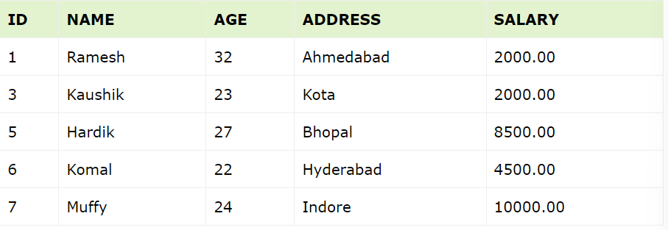
SELECT * FROM CUSTOMERS;

